Slide 1
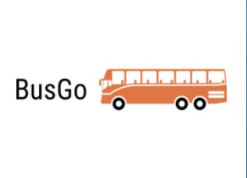

BusGo
User Friendly bus booking website
Team Members-
Swapnil Kothari
Rhea Shree
Tushar Bansal
Sanchay Bharara

Slide 2
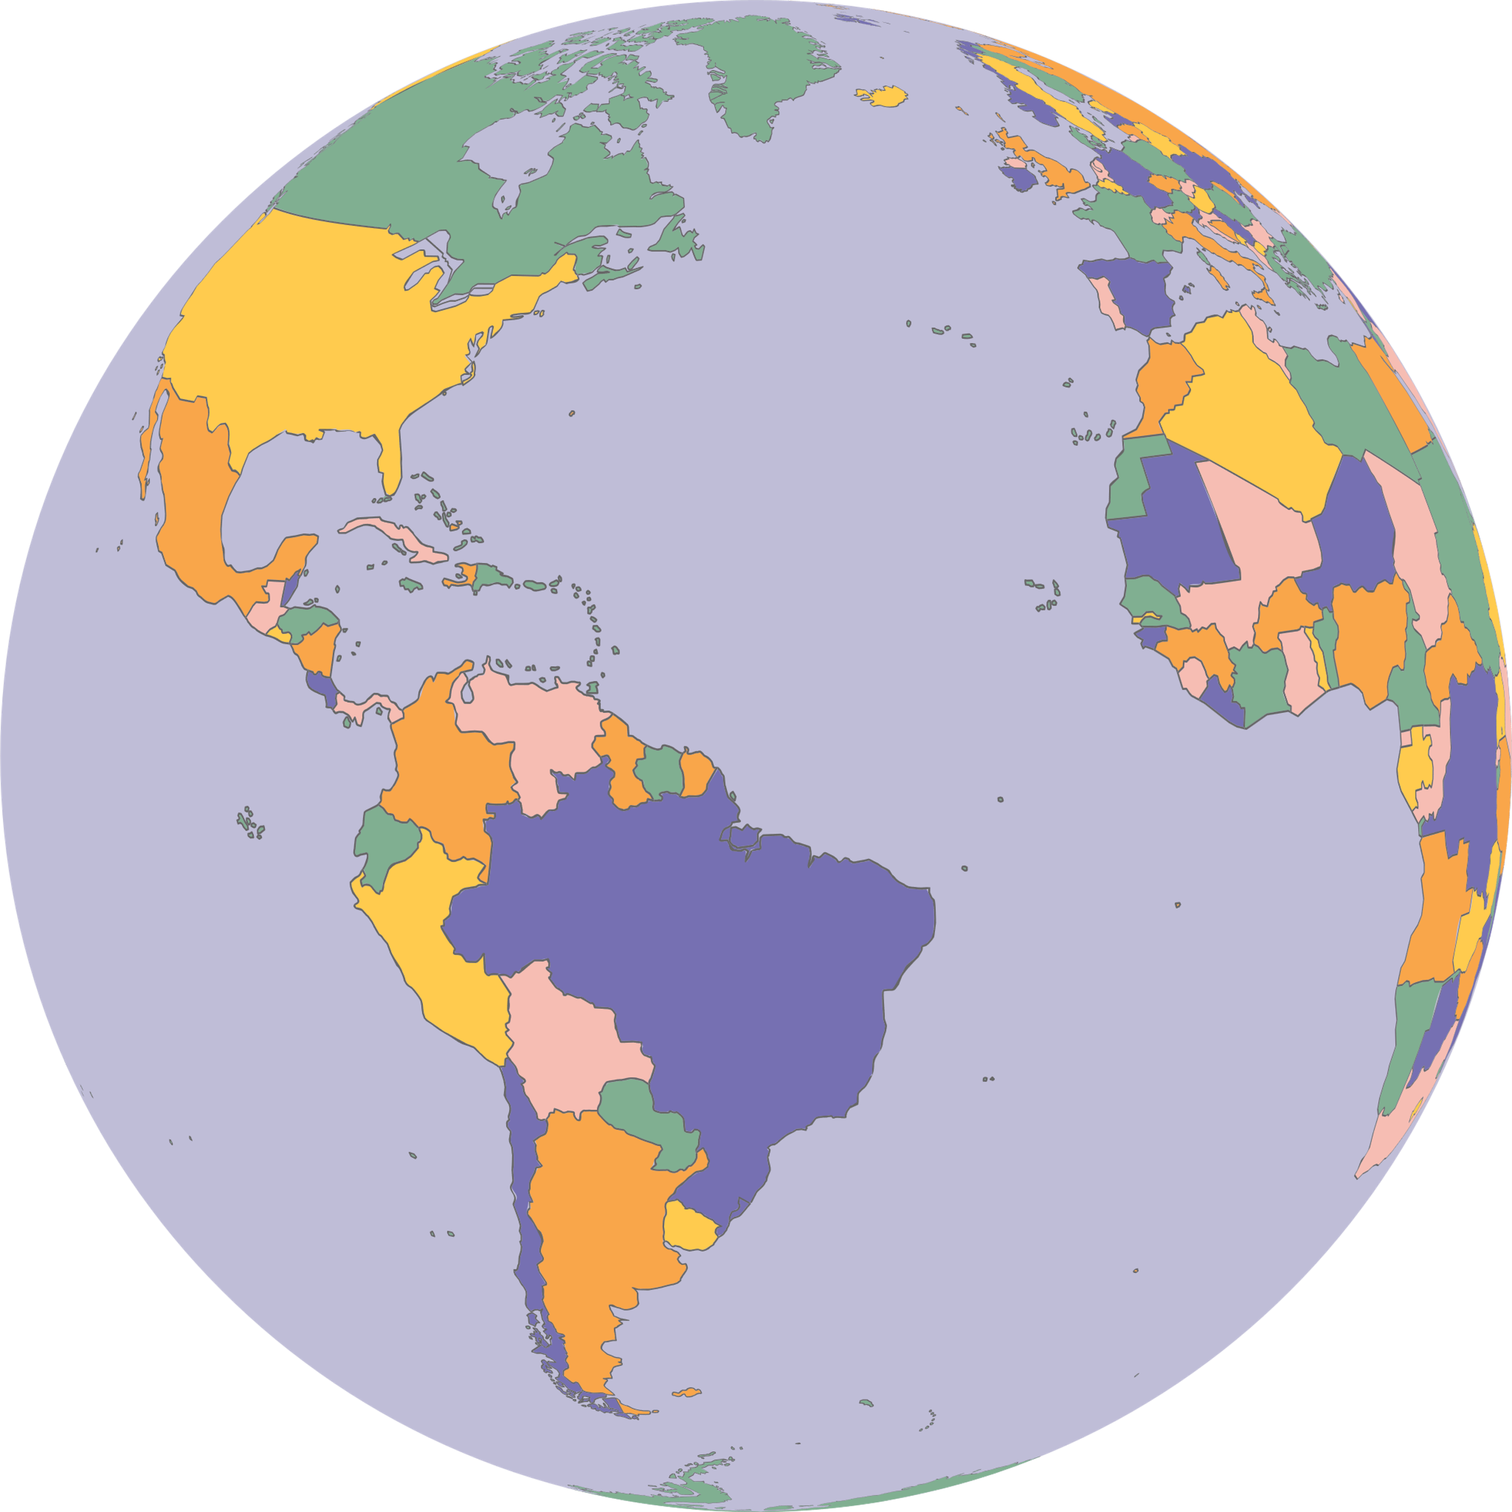
Introduction
With Pune facing growing traffic congestion, particularly during peak hours, resulting in extended bus delays and passenger frustration due to longer travel times, there's an urgent need for a solution. These delays not only frustrate passengers but also introduce inefficiencies in the ticketing process, especially during crowded journeys. BusGo, our user-friendly web-based application, aims to address these issues by providing electronic bus tickets, real-time bus tracking, and QR code scanning for conductors. It also offers insights into bus occupancy levels, making travel more convenient and safe, particularly for newcomers to the city.

Slide 3

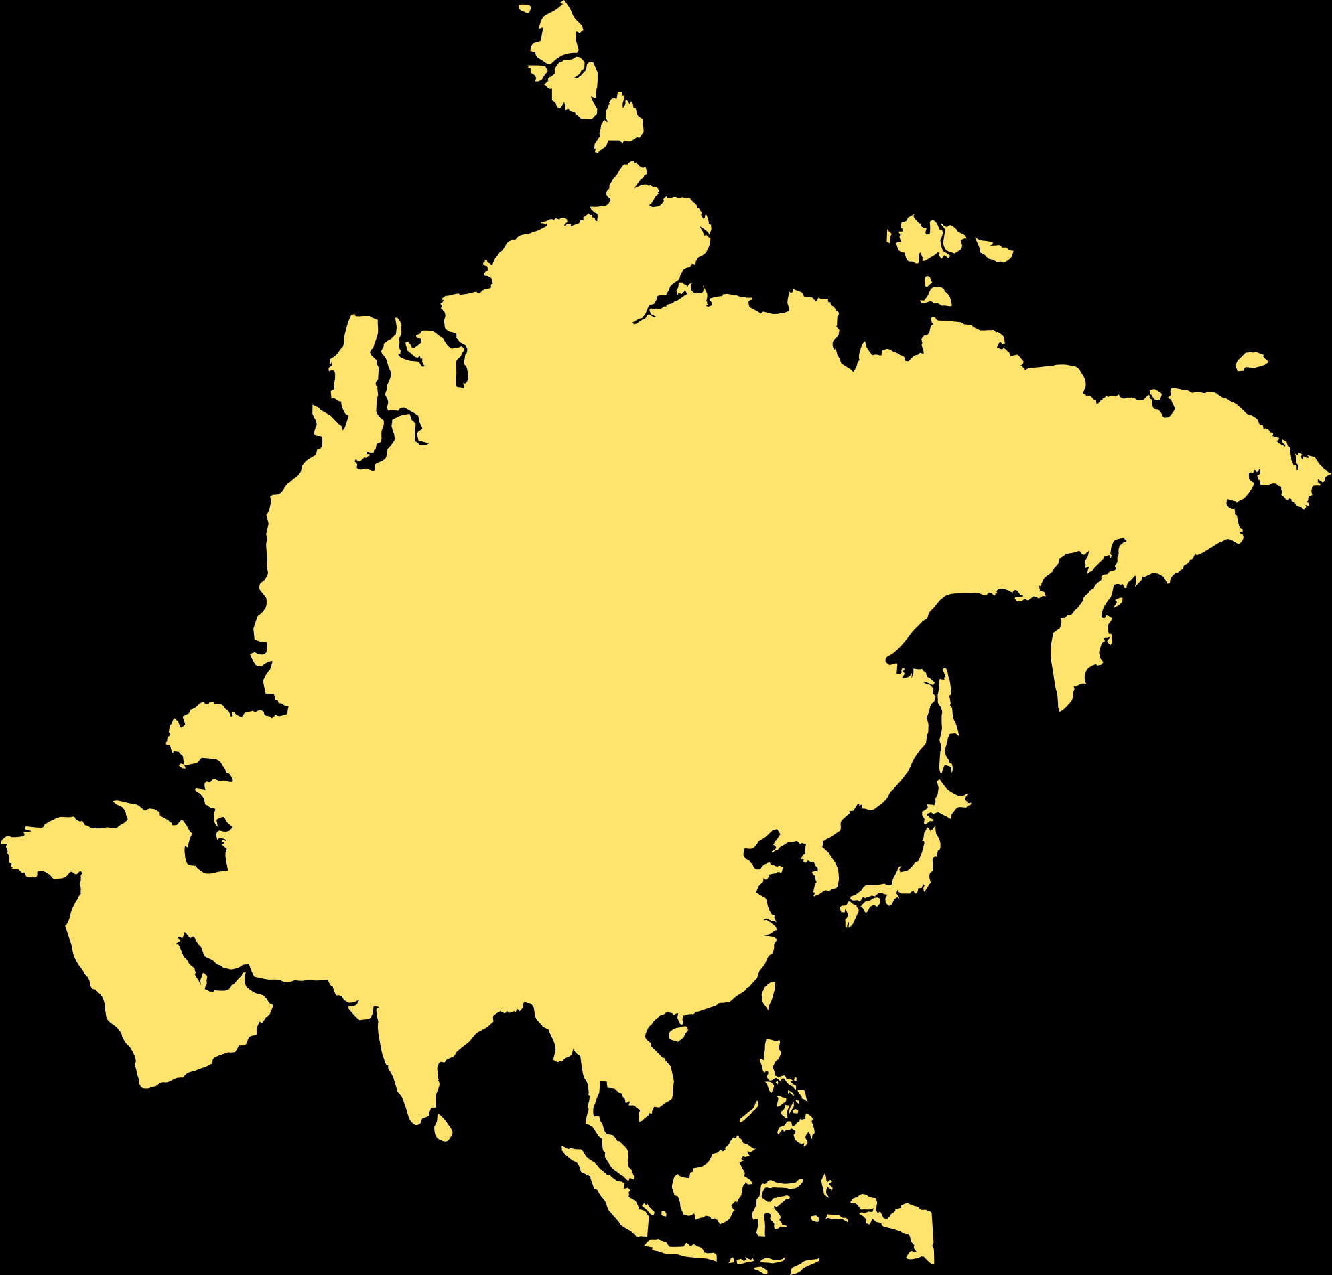

Vision of BusGo
BusGo aims to become the go-to platform for users looking to book tickets for bus travel , offering a seamless experience, personalized recommendations, and a user-centric approach to ticket booking. The application will redefine convenience and ease in the way users access and secure their tickets.

Slide 4
Mission of BusGo
Our objective is to build an advanced web-based application that enhances traveler experiences by simplifying reservations, offering comprehensive bus and route details, ensuring accessibility and reliability, promoting sustainability, valuing user feedback, prioritizing security, and embracing innovation. Our platform aims to make bus travel hassle-free, providing a seamless and efficient booking process while prioritizing the needs and preferences of our users.

Slide 5

Product overview and its objectives
BusGo is a user-friendly web-based application that simplifies bus ticketing and route information.
It allows passengers to create electronic bus tickets for their chosen routes
The app provides real-time bus location tracking, enabling passengers to plan their journeys better.
Conductors benefit from the app as well, as they only need to scan QR codes for ticket validation.
BusGo also offers information on bus occupancy, making it a valuable tool for newcomers to a city, enhancing convenience in travel.

Slide 6

How BusGo is different from other E-Busticket platforms
BusGo differentiates itself by focusing enhancing passenger convenience and reducing frustrations during travel. Conductors benefit from streamlined ticketing through passenger-generated QR codes, improving efficiency. With a user-friendly interface, BusGo caters to all age groups, aiding newcomers in navigating the bus system effectively.
By eliminating physical tickets, providing real-time tracking, and enhancing conductor operations, BusGo prioritizes time and effort savings for both passengers and staff, making it a valuable choice in bus ticketing, particularly in congested urban areas like Pune.

Slide 7
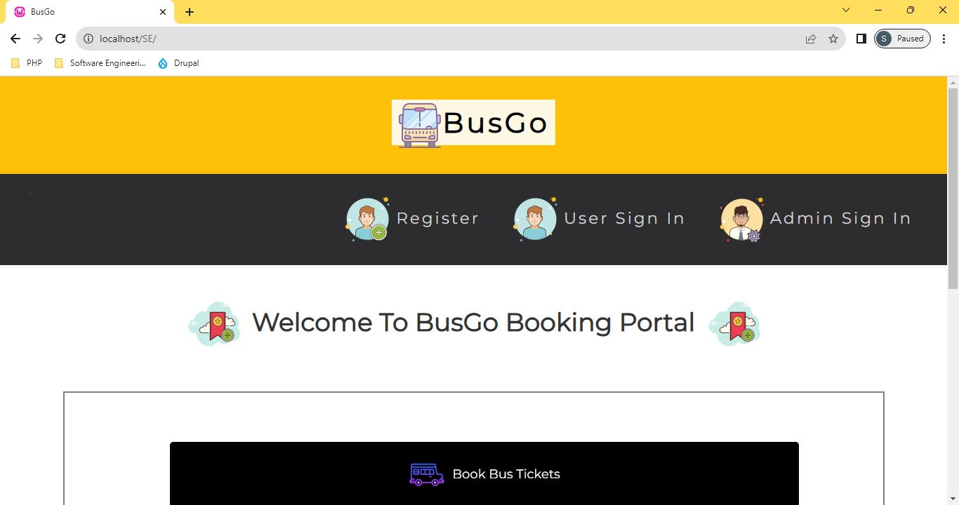
Welcome page Of BusGo

Slide 8
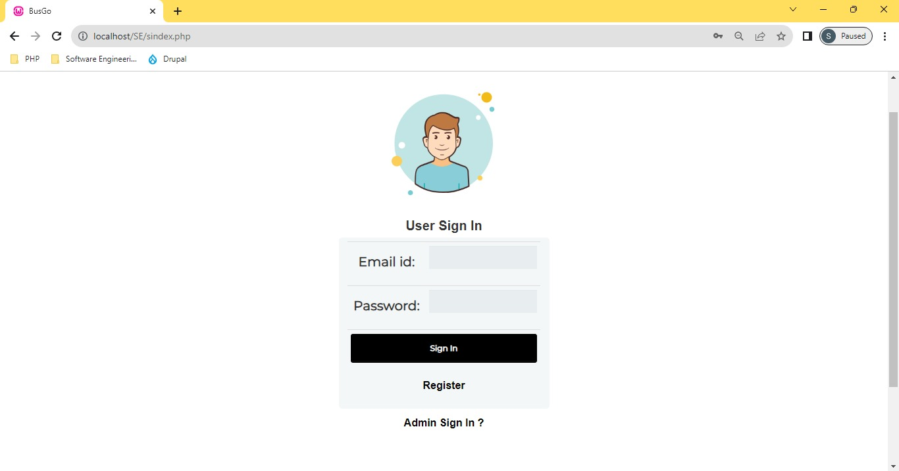
Login Page Of BusGo

Slide 9
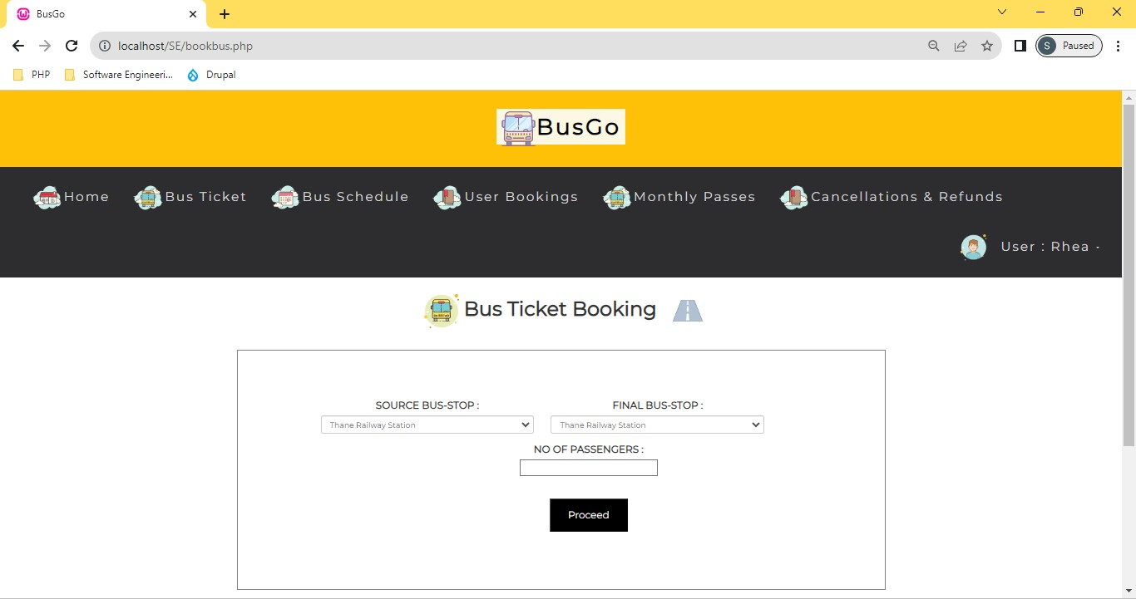
Booking ticket page Of BusGo

Slide 10
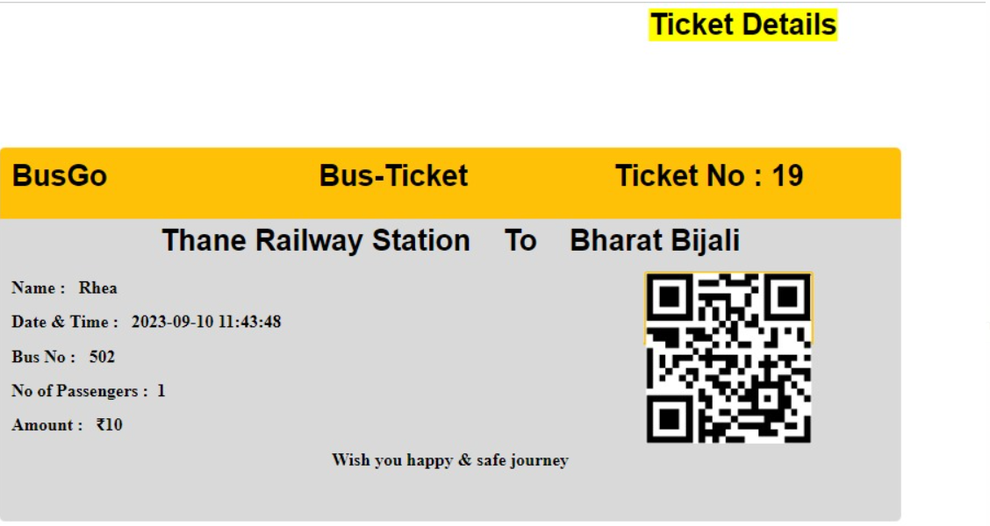
Electronic Ticket Of BusGo

Slide 11
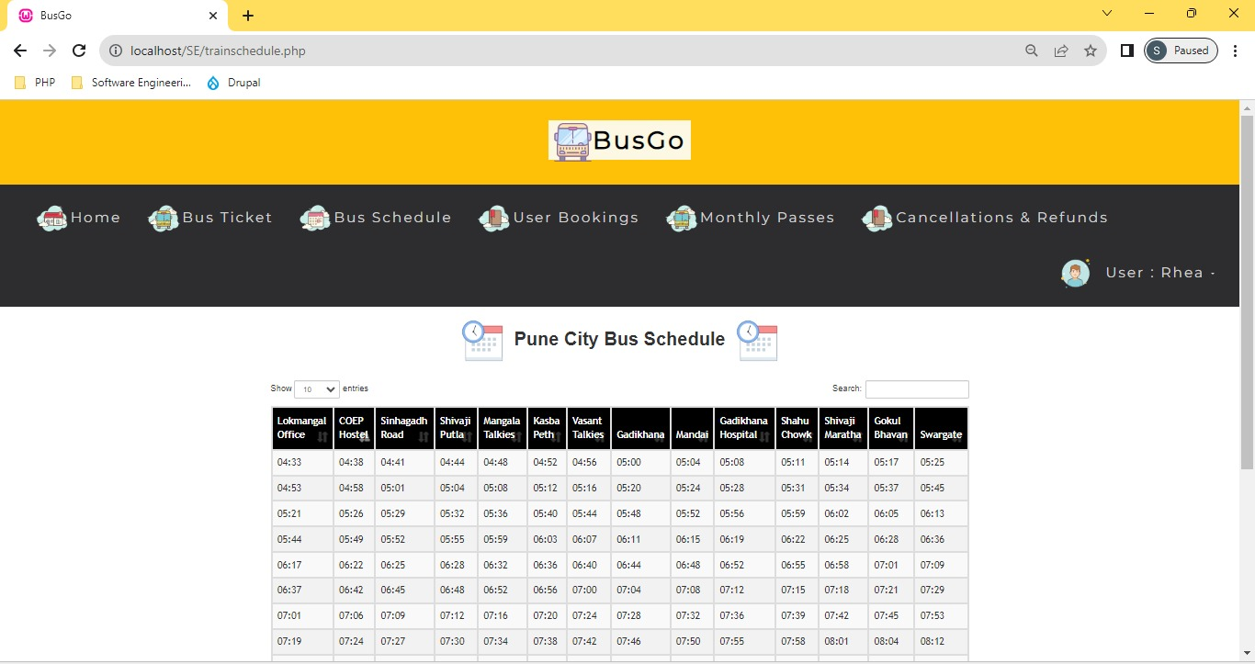
Bus schedule

Slide 12
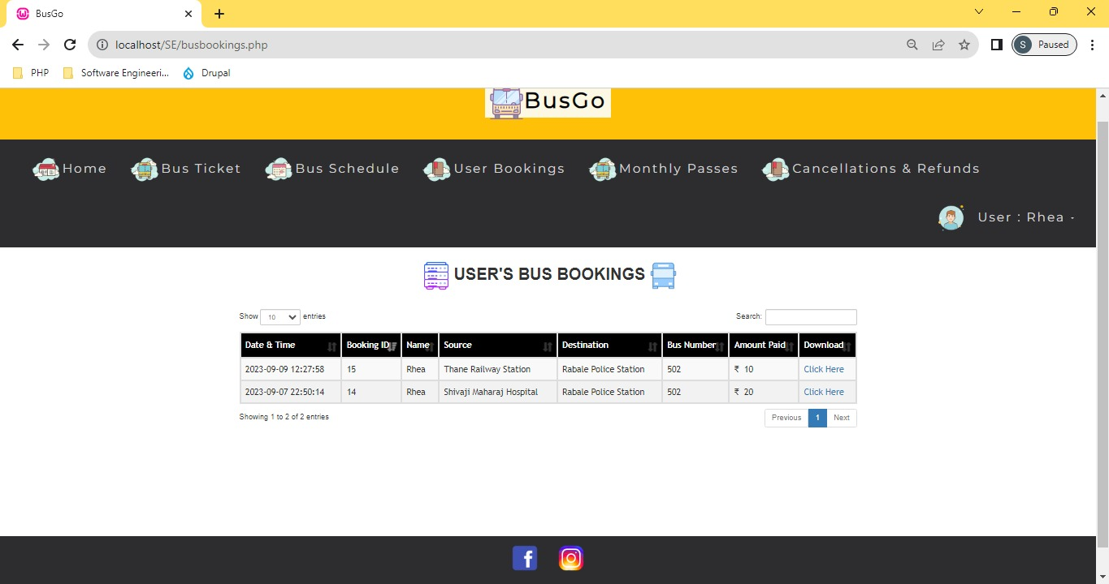
User Bus Booking

Slide 13
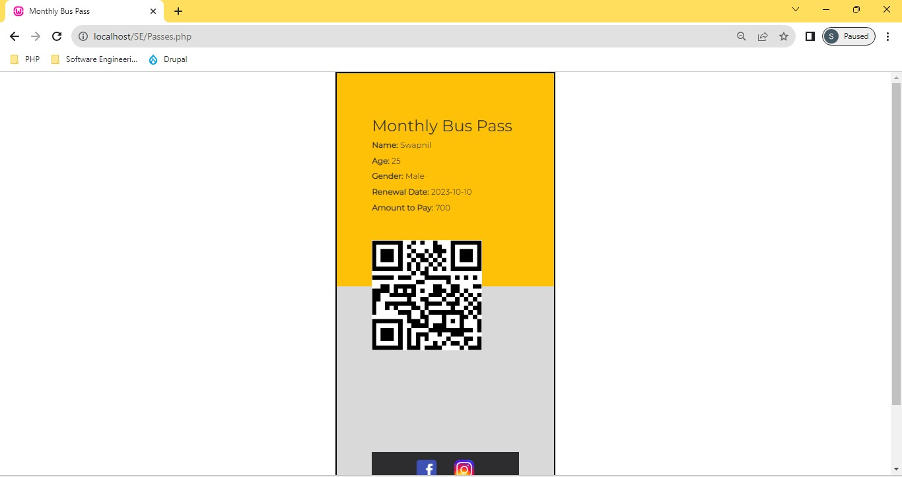
Monthly Bus passes on BusGo

Slide 14
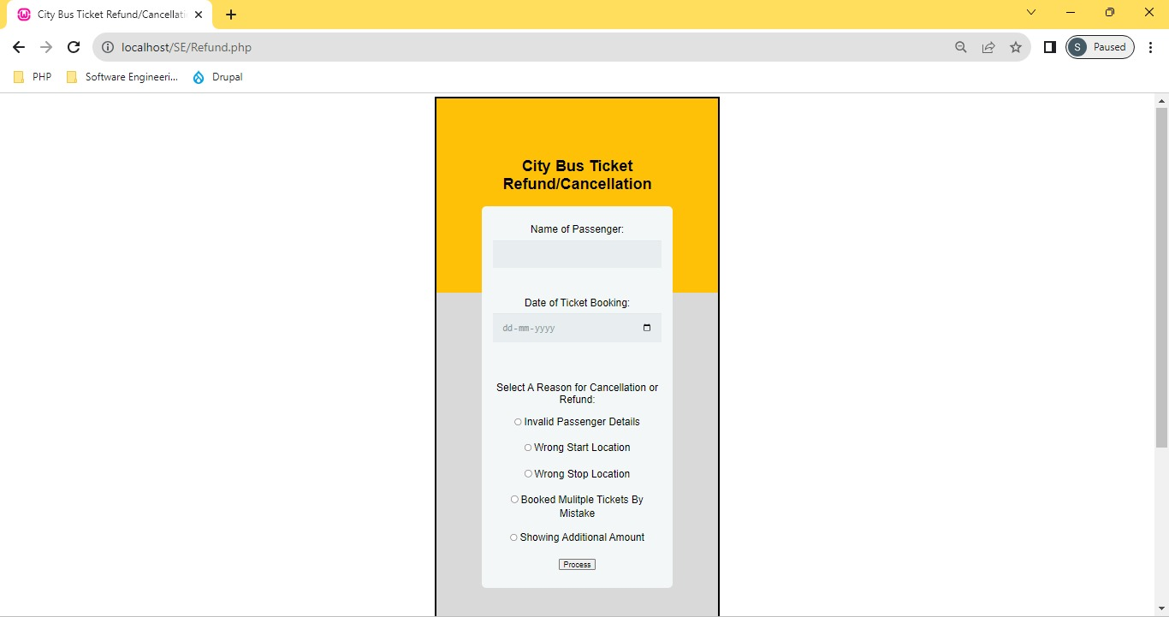
Cancellation and refund On BusGo

Slide 15
Why choose BusGo
Our city bus ticket booking app represents a significant step forward in the realm of public transportation and convenience for urban commuters. Through the course of this presentation, We have focused on developing the essential features and functions for our software engineering project, including: :
• Enhanced User Experience
• Efficient Bus Management
• Accessibility and Inclusivity
• Reduced Environmental Impact
• Seamless Booking Process
• Security and Privacy

Slide 16
Conclusion
In conclusion, our city bus ticket booking app is not just a software engineering project but a practical solution to improve urban transportation, promote sustainability, and enhance the overall quality of life for city residents. We are excited to see the positive impact this app will have on our city and look forward to its continued success and development.

Slide 17
Our Learnings
Working together as a team on our software project has taught us some important lessons. We've learned that in software development, collaboration is not just beneficial; it's essential. Our collective effort in each aspect of the project has emphasized that a united team is better equipped to overcome obstacles in the field of software development. Through teamwork, we learned that good communication, trust, and using each other's strengths can lead to great results.

Slide 18


